Slide 1

Recursion and recursive algorithms
By Georgi Stoimenov

Slide 2

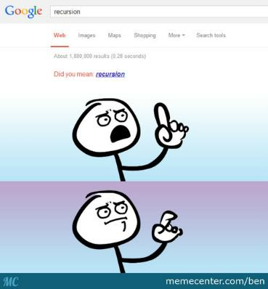

What is actually a recursion?

Slide 3

Recursion in programming is…
“Recursion is a method where the solution to a problem depends on solutions to smaller instances of the same problem (as opposed to iteration)”
Wikipedia

Slide 4

The Fibonacci sequence - Demo
Click me!

Slide 5

How it works?
Fib(4)
Fib(3)
Fib(2)
Fib(2)
Fib(1)
Fib(0)
Fib(1)
Fib(0)

Slide 6



Specifics of the recursion
Bottom
Depth
Directions

Slide 7

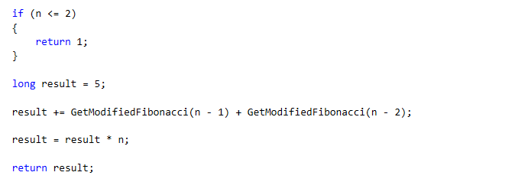
Modified Fibonacci
Bottom
Straight move
Backward move

Slide 8


Recursion types
Direct
Indirect
Tail

Slide 9
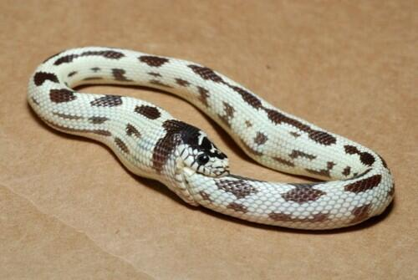
Tail recursion
In tail recursion, you perform your calculations first, and then you execute the recursive call.

Slide 10

Tail recursion: calculation of Factorial - Demo

Slide 11

Recursive algorithms
A common computer programming tactic is to divide a problem into sub-problems of the same type as the original, solve those sub-problems, and combine the results.

Slide 12
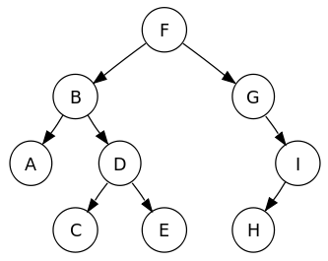
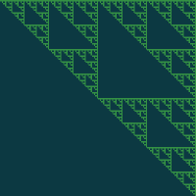

Interesting algorithms with recursion
Find path in labyrinth
Tree traversal
Click me!

Slide 13

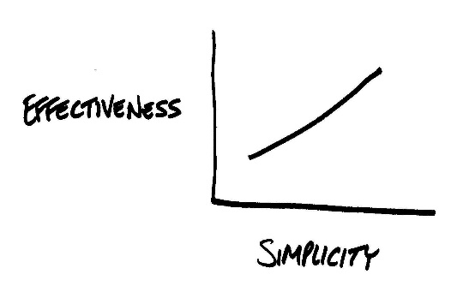
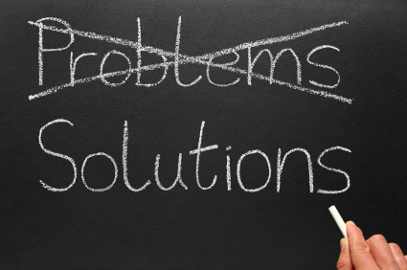
What is the idea behind Recursion?

Slide 14

Is recursion always applicable?
When using big data or even bad algorithm
can cause StackOverflow Exception.
May require more memory (because of stack).
It's usually slower due to the overhead of maintaining the stack.

Slide 15




What is the alternative?
Iteration
Works well with big data.
No additional memory used.
Easy calculation of time complexity of the algorithm.

Slide 16

Conclusion
Using recursion makes
your code simple and
understandable. It can
be used to solve
difficult tasks with
ease.
However stepping
out the boundary
can make your
algorithm slow and
uneffective.

Slide 17

Thanks for the attention!
https://goo.gl/qNOuLe

